Slide 1
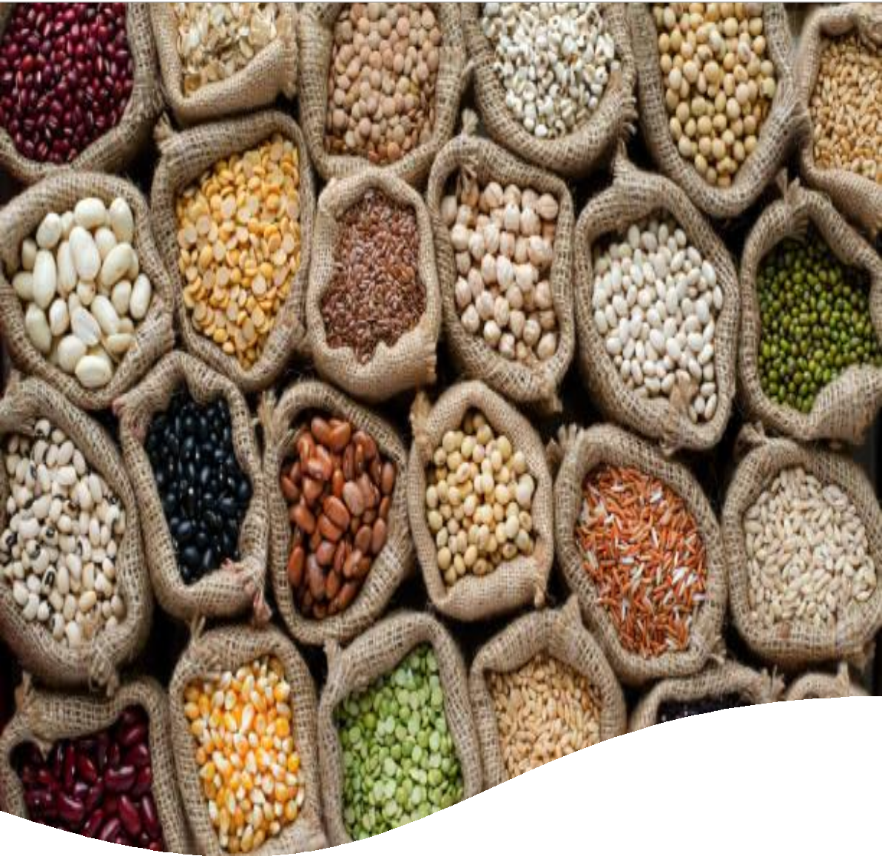



Nigeria | Macroeconomics
Inflation Report
October 2024
Meristem Research
November 2024

Slide 2

Macroeconomic Update
Inflation Report for October 2024
Key Summary Statistics
The National Bureau of Statistics (NBS) reported that Consumer Price Index (CPI) ticked upward for the second consecutive month in October 2024, registering at 33.88% YoY from 32.70% in September, representing a 118bs increase from the prior month. The surge can be attributed to significant increases in both the food and core inflation, reaching 39.16% and 28.37%, respectively, compared to 31.52% and 22.58% in October 2023. The increase in annual food inflation was attributed to increases in the prices of Rice, Corn, Palm oil, Vegetable Oil, Yam and other Tubers and Guinea Corn. Additionally, the increase in the core index was driven by a rise in the prices of Passenger transport by road, Actual and imputed rentals for housing, and Accommodation services. On a month-on-month basis, the headline, food, and core inflation increased to 2.64%, 2.94% and 2.14% MoM respectively, (vs 2.52%, 2.64%, and 2.10% in September 2024).
Category | Oct-2024 | Sept-2024 | Oct-2023
Headline Inflation | 33.88% | 32.70% | 27.33%
Food Inflation | 39.16% | 37.77% | 31.52%
Core Inflation | 28.37% | 27.43% | 22.58%
Imported Food Inflation | 40.96% | 39.51% | 22.76%
Chart 1: Trend in Headline, Food, and Core Inflation (YoY
% Change)
Food Prices Surge Amidst Ongoing Harvest Season
Food inflation accelerated to 39.16% YoY in October 2024, surpassing our forecast by 66bps. On a monthly basis, food prices rose by 2.94% MoM, compared to 2.64% MoM in September 2024, driven by significant price increases in major staples. This upward pressure reflects the continued impact of the floods from previous months reducing output during the ongoing harvest season for crops like soyabean, yam, rice and corn. Additionally, ongoing challenges in the country’s food producing region and elevated transport costs—spurred by a 15% MoM increase in PMS prices—exacerbated inflationary pressures. Evidently, the farm produce index and the processed food index both surged by 38.51% YoY and 39.34% YoY, respectively (vs 37.18% and 37.94% in September), reflecting heightened price pressures during the month.
Source: NBS, Meristem Research
In the near term, food prices are expected to rise further, fueled by heightened transportation costs and increased consumer demand ahead of the festive season. Additionally, projections from the Nigeria Hydrological Services Agency (NIHSA) warn of potential flooding in states along the River Niger, which could disrupt harvests and further strain agricultural output, exacerbating inflationary pressures on food prices.
Chart 2: Monthly Inflation Trend (MoM % Change)
Upward Momentum Resumes in Core Inflation
The core index surged to a record high of 28.37% YoY in October 2024, (below our forecast by 27bps), compared to 27.43% in September 2024 and 22.58% in October 2023. On a monthly basis, the index rose by 2.14% MoM, up from 2.10% in September. This upward trend was primarily driven by increased fuel prices and persistent volatility in the Naira, which depreciated by 2.77% MoM on the NAFEM window to NGN1,635.11/USD in October 2024.
Significant contributions to this rise came from key sub-indices, including Transport (29.26% YoY vs 27.21% in September), Housing, Water, Electricity & Gas (28.85% YoY vs 28.61%), Furnishings & Household Equipment Maintenance (21.54% YoY vs 20.76%), and Restaurants & Hotels (33.01% YoY vs 30.46%).
Source: NBS, Meristem Research
Looking ahead, we anticipate further upward pressure on the core index, largely driven by rising transportation costs stemming from elevated fuel prices. Additionally, heightened demand for foreign exchange during the festive season is likely to exacerbate the depreciation of the Naira, further inflating the prices of goods and services within the core inflation basket.

Slide 3
Contact Information
Investment Research
praiseihansekhien@meristemng.com research@meristemng.com | (+234 817 007 1512)
Corporate websites: www.meristemng.com www.meristemwealth.com www.meristemregistrars.com
Meristem Research can also be accessed on the following platforms:
Meristem Research portal: research@meristemng.com
Bloomberg: MERI <GO>
Capital IQ: www.capitaliq.com
ISI Emerging Markets: www.securities.com/ch.html?pc=NG
Reuters: www.thomsonreuters.com
FactSet: www.factset.com
IMPORTANT INFORMATION: DISCLAIMER
Meristem Securities Limited ("Meristem") equity reports and its attendant recommendations are prepared based on publicly available information and are meant for general information purposes only and it may not be reproduced or distributed to any other person. All reasonable care has been taken to ensure that the information contained herein is not misleading or untrue at the time of publication; Meristem can neither guarantee its accuracy nor completeness as they are an expression of our analysts' views and opinions.
Meristem and any of its associated or subsidiary companies or the employees thereof cannot be held responsible for any loss suffered by relying on the said information as this information as earlier stated, is based on publicly available information, analysts' estimates and opinions, and is meant for general information purposes and should not be construed as an offer to buy or sell or a solicitation of an offer to buy or sell securities or any financial instruments. The value of any investment is subject to fluctuations, i.e., may fall and rise. Past performance is no guide to the future. The rate of exchange between currencies may cause the value of investment to increase or diminish. Hence investors may not get back the full value of their original investment. Meristem Securities is registered with the Securities and Exchange (SEC) and is also a member of The Nigerian Stock Exchange (NSE). Meristem Securities' registered office is at 20A Gerrard Road, Ikoyi, Lagos, Nigeria. Website: www.meristemng.com; Email: research@meristemng.com. © Meristem Securities Limited 2024.

